Slide 1
Introduction to Database Programming through ADO. NET
By
Prakash G Asnani
Assistant Professor Computer Science
Government Science College Chikhli

Slide 2
What is ADO.Net?
The data access classes for the .Net framework
Designed for highly efficient data access
Support for XML and disconnected record sets
A standard cross language interface
Encapsulation of services, classes and data types
Uses XML for data representation

Slide 3
ADO. NET in Visual Studion .NET Framework
VB
C#
C++
Jscript
…
Common Language Specification
ASP.Net
Windows Forms
ADO.Net
XML.Net
Visual Studio .NET
Base Class Library
Common Language Runtime (CLR)
Windows

Slide 4
About ADO and its comparison with ADO .NET
ADO still exists.
ADO is tightly coupled to client server architectures
Needs COM marshalling to pass data between tiers
Connections and locks are typically persisted
Feature | ADO | ADO.Net
In memory data storage | Recordset object Mimics single table | Dataset object Contains DataTables
Data Reads | Sequential | Sequential or non-sequential
Data Sources | OLE/DB via the Connection object | Managed provider calls the SQL APIs

Slide 5
Feature | ADO | ADO.Net
Disconnected data | Limited support, suitable for R/O | Strong support, with updating
Passing datasets | COM marshalling | DataSet support for XML passing
Scalability | Limited | Disconnected access provides scalability

Slide 6
.NET Data Providers
SQL .NET
Data Provider
SQL SERVER
OLE DB .NET
Data Provider
OLE DB
Provider
Client
Other DB
ODBC .NET
Data Provider
ODBC
Driver
Other DB

Slide 7
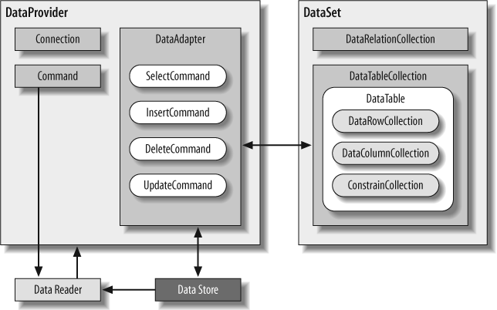
ADO.Net object model

Slide 8
Namespaces
System.Data & System.Data.Common
System.Data.SqlClient & System.Data.OleDB
System.Data.SqlTypes
System.XML & System.XML.Schema

Slide 9
Using Namespaces
VB.Net Imports System.Data Imports System.Data.SqlClient Dim sqlAdp as SqlDataAdapter
C# using System.Data; using System.Data.SqlClient; SqlDataAdapter sqlAdp= new SqlDataAdapter();

Slide 10
SQL Namespace Objects
using System.Data.SqlClient;
SqlConnection
SqlCommand
SqlDataReader
SqlDataAdapter
SqlParameter
SqlParameterCollection
SqlError
SqlErrorCollection
SqlException
SqlTransaction
SqlDbType

Slide 11
Connecting to SQL
using System.Data.SqlClient; string sConnectionString = "Initial Catalog=Northwind; Data Source=localhost; Integrated Security=SSPI;"; SqlDataAdapter sqlAdp= new SqlDataAdapter(sConnectionString); sqlAdp.Close(); sqlAdp.Dispose();

Slide 12
Connection Pooling
ADO.Net pools connections. When you close a connection it is released back into a pool.
SqlConnection conn = new SqlConnection(); conn.ConnectionString = "Integrated Security=SSPI;Initial Catalog=northwind"; conn.Open(); // Pool A is created.
SqlConnection conn = new SqlConnection(); conn.ConnectionString = "Integrated Security=SSPI;Initial Catalog=pubs"; conn.Open(); // Pool B is created because the connection strings differ.
SqlConnection conn = new SqlConnection(); conn.ConnectionString = "Integrated Security=SSPI;Initial Catalog=northwind"; conn.Open(); // The connection string matches pool A.

Slide 13
Getting data
SqlCommand ExecuteReader ExecuteNonQuery ExecuteScalar ExecuteXMLReader
SqlDataAdapter DataSet

Slide 14
Using the command object
SqlCommand Multiple constructors
New()
New(cmdText)
New(cmdText, connection)
New(cmdText, connection, transaction)

Slide 15
Using the command object
string sSelectQuery = "SELECT * FROM Categories ORDER BY CategoryID"; string sConnectionString = "Initial Catalog=Northwind; Data Source=localhost; Integrated Security=SSPI;"; SqlConnection objConnect = new SqlConnection(sConnectString); SqlCommand objCommand = new SqlCommand(sSelectQuery, objConnect); /*
objCommand.CommandTimeout = 15; objCommand.CommandType = CommandType.Text;
*/ objConnect.Open(); SqlDataReader drResults; drResults = objCommand.ExecuteReader() drResults.Close(); objConnect.Dispose();

Slide 16
Command Methods
.ExecuteReader() - Returns DataReader
.ExecuteNonQuery() - Returns # of Rows Affected
.ExecuteXMLReader() - Returns XMLReader Object to Read XML documentation
.ExecuteScaler() - Returns a Single Value e.g. SQL SUM function.

Slide 17
The DataReader object
DataReader objects are highly optimised for fast, forward only enumeration of data from a data command
A DataReader is not disconnected

Slide 18
The DataReader object
Access to data is on a per record basis.
Forward only
Read only
Does support multiple recordsets

Slide 19
Creating a data reader
SqlDataReader sqlReader;
sqlReader = sqlCommand.ExecuteReader();
while (sqlReader.Read())
{
// process, sqlReader("field")
}
sqlReader.Dispose();

Slide 20
DataSets
In-memory representation of data contained in a database/XML
Operations are performed on the DataSet, not the data source
Can be created programmatically, using a DataAdapter or XML schema and document (or any mixture)

Slide 21
Creating DataSets
Setup SqlConnection
Setup a SqlDataAdapter
Create a DataSet
Call the .Fill() method on the DA

Slide 22
DataAdapters
Pipeline between DataSets and data sources
Geared towards functionality rather than speed
Disconnected by design
Supports select, insert, delete, update commands and methods
Must always specify a select command
All other commands can be generated or specified

Slide 23
Using the DataAdapter
SQLDataAdapter sqlDA = new SqlDataAdapter();
sqlDA.SelectCommand = new SqlCommand ("select * from authors“, sqlConnection);
DataSet sqlDS = new DataSet("authorsTable");
sqlDA.Fill(sqlDS, "authorsTable");

Slide 24
DataAdapters
For speed and efficiency you should set your own InsertCommand, UpdateCommand and DeleteCommand
Call GetChanges to seperates the updates, adds and deletes since the last sync. Then sync each type.

Slide 25
References
ADO.Net Programmer’s Reference Bilbija, Dickenson et al. Wrox Press
http://oberon.idunno.org/sql/
My email : desai8@uwindsor.ca
An Introduction to ADO.Net by Marmagna Desai

Slide 26
Thank You

